Slide 1
Relative Clauses in Latin and Oscan
James Clackson
University of Cambridge

Slide 2
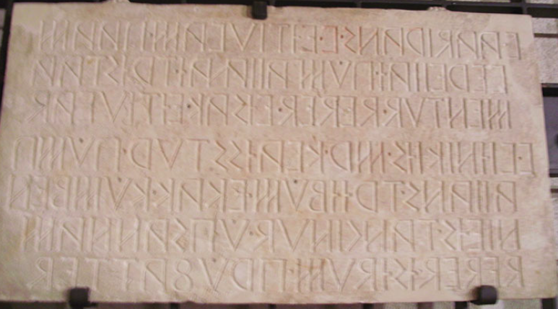
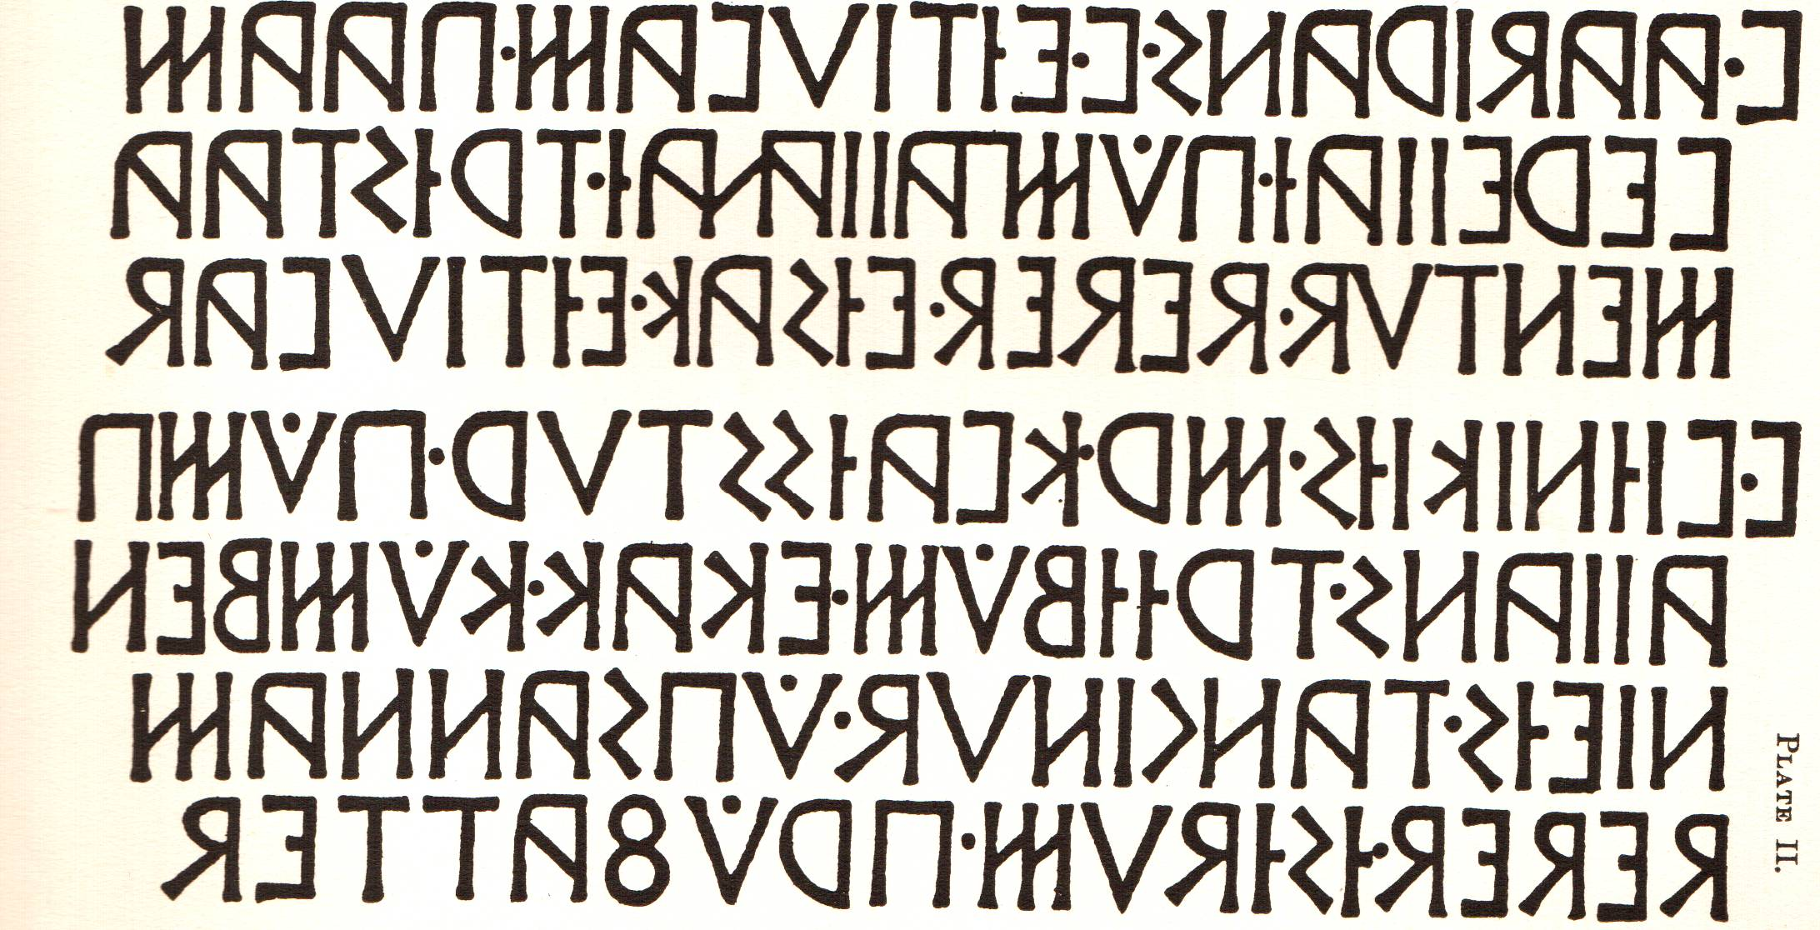
Pompei 24 ST Po 3 Testament of Vibis Aadirans
Vibis Aadirans, son of Vibis, gave money in his will to
the vereiia- of Pompeii; with this money Vibis Viínikiís,
son of Maras, quaestor of Pompeii, gave the construction
of this building by decision of the senate.
The same man approved it.

Slide 3
Pompei 24 ST Po 3 Testament of Vibis Aadirans
v(iíbis). aadirans. v(iíbieís). eítiuvam. paam/
vereiiaí. púmpaiianaí. trístaa/mentud.
deded. eísak. eítiuvad /
v(iíbis). viínikiís. m(a)r(aheis). kvaísstur. pump/aiians.
trííbúm. ekak. kúmben/nieís.
tanginud. úpsannam /
deded. ísídum. prúfatted
V(ibius) Atranus V(ibi f.)
pecuniam quam
iuventuti Pompeianae testament
dedit, ea pecunia
V. Vinicius M(a)r(aei f.) quaestor Pompeianus
domum hanc (de) conventus sententia faciendam
dedit, idem probavit
Vetter (1953: 49-50).

Slide 4
Pompei 24 ST Po 3 Testament of Vibis Aadirans
v(iíbis). aadirans. v(iíbieís). eítiuvam. paam/
vereiiaí. púmpaiianaí. trístaa/mentud.
deded. eísak. eítiuvad /
v(iíbis). viínikiís. m(a)r(aheis). kvaísstur. pump/aiians.
trííbúm. ekak. kúmben/nieís.
tanginud. úpsannam /
deded. ísídum. prúfatted
1) relative clause preposed
eítiuvam (pecuniam) both in relative clause and in matrix clause, accompanied by correlative pronoun eísak (ea)
3) so-called attractio inversa

Slide 5
Pompei 24 ST Po 3 Testament of Vibis Aadirans
v(iíbis). aadirans. v(iíbieís). eítiuvam. paam/
vereiiaí. púmpaiianaí. trístaa/mentud.
deded. eísak. eítiuvad /
v(iíbis). viínikiís. m(a)r(aheis). kvaísstur. pump/aiians.
trííbúm. ekak. kúmben/nieís.
tanginud. úpsannam /
deded. ísídum. prúfatted
Watkins (1995: 541) compared structure of Artharva Veda 2.31.1,
índrasya yā mahī dṛṣát
krímer víśvasya tárhaṇī
táyā pinaṣmi sáṃ krímīn
dṛṣádā khálvāṁ iva
‘The great millstone which is Indra’s, bruiser of every worm, with that millstone I crush the worms like khalva-grains’
‘We have a feature of Vedic formal style which recurs in the ‘high style’ of Archaic Latin, of Hittite, and also of Oscan...’

Slide 6
Latinisms and possible Latinisms in Vibis Aadirans
v(iíbis). aadirans. v(iíbieís). eítiuvam. paam/
vereiiaí. púmpaiianaí. trístaa/mentud.
deded. eísak. eítiuvad /
v(iíbis). viínikiís. m(a)r(aheis). kvaísstur. pump/aiians.
trííbúm. ekak. kúmben/nieís.
tanginud. úpsannam /
deded. ísídum. prúfatted
kvaísstur loaned from Latin quaestor
trístaamentud calqued after Latin testamentum
trístaamentud. deded
testamento dedit
kúmbennieís. tanginud
(de/ ex) senatus sententia
úpsannam. deded. faciendam dedit
dedit ísídum. prúfatted
dedit idem probavit

Slide 7
Latin legal texts with similar structures
CIL 5 7749 (117 BCE) (Sententia Minuciorum) 42-4
Vituries quei controvorsias / Genuensium ob iniourias iudicati aut damnati sunt, sei quis in vinculeis ob eas res est, eos omneis / solvei, mittei leiber〈are〉ique Genuenses videtur oportere ante eidus Sextilis primas.
(NB Vituries is 2nd declension nominative plural)
CIL I² 698 (105 BCE) (Lex parieti faciendo Puteolana) 8-10
In area trans uiam paries, qui est propter uiam in eo pariete medio ostiei lumen aperito;
CIL I² 587 (81 BCE) (Lex Cornelia de XX quaestoribus) 31-33
uiatores praecones quei ex hac lege lectei sublectei erunt /
eis uiatoribus praeconibus magistratus proue mag(istratu) / mercedis item tantundem dato

Slide 8
Latin legal texts with similar structures
CIL 5 7749 (117 BCE) (Sententia Minuciorum) 42-4
Vituries quei controvorsias / Genuensium ob iniourias iudicati aut damnati sunt, sei quis in vinculeis ob eas res est, eos omneis / solvei, mittei leiber〈are〉ique Genuenses videtur oportere ante eidus Sextilis primas.
(NB Vituries is 2nd declension nominative plural)
CIL I² 698 (105 BCE) (Lex parieti faciendo Puteolana) 8-10
In area trans uiam paries, qui est propter uiam in eo pariete medio ostiei lumen aperito;
NB parallel to Vibis Aadirans with another element before the head noun
CIL I² 587 (81 BCE) (Lex Cornelia de XX quaestoribus) 31-33
uiatores praecones quei ex hac lege lectei sublectei erunt /
eis uiatoribus praeconibus magistratus proue mag(istratu) / mercedis item tantundem dato

Slide 9
Is Vibis Aadirans’ relative clause also a Latinism?
Similar constructions in both early and late Latin texts in different registers
e.g. Apuleius Florida 9.13 21 (2nd half of 2nd century CE)
etiam anulum in laeva aureum faberrimo signaculo
quem ostentabat, ipse
eius anuli et orbiculum circulauerat
et palam clauserat et gemmam insculpserat
‘and as for the gold ring on his left hand which he flaunted with its exquisite seal stone, he himself had molded the band, enclosed the bezel, and carved the intaglio’ (Loeb translation by C.P. Jones)

Slide 10
Is Vibis Aadirans’ relative clause also a Latinism?
1st century inscriptional example from Pompeii
AE 1964, 160, 3-5, from tomb of Vesonius Phileros
amicum hunc quem / speraueram mi esse
ab eo mihi accusato/res subiecti et iudicia instaurata
‘this friend I hoped I had, by him accusers have been brought forward against me and a lawsuit started’ (Probert & Dickey 2016: 395)

Slide 11
Is Vibis Aadirans’ relative clause also a Latinism?
But text is longer:
Hospes paullisper morare
si non est molestum et quid evites
cognosce amicum hunc quem
speraueram mi esse ab eo mihi accusato
res subiecti et iudicia instaurata deis
gratias ago et meae innocentiae omni
molestia liberatus sum qui nostrum mentitur
eum nec di penates nec inferi recipiant
Pinkster 2021: 491 ‘the accusative… may be due to preceding cognosce as a false start of an accusative and infinitive clause’

Slide 12
Comparisons with other Oscan relative clauses
Oscan (including Paelignian etc.) relative clauses
formed with relative pronoun púí = Latin qui < *k^{w}o- c. 38 examples
formed with relative pronoun pís = Latin quis < *k^{w}i- c. 6 examples

Slide 13
Comparisons with other Oscan relative clauses
Oscan (including Paelignian etc.) relative clauses
formed with relative pronoun púí = Latin qui < *k^{w}o- c. 38 examples
formed with relative pronoun pís = Latin quis < *k^{w}i- c. 6 examples
Of these, 10 are found in the Tabula Bantina (Bantia 1 / Lu 1) an Oscan legal text of c. 100-91 BCE, written in Latin script and widely recognized to have heavy Latin influence.

Slide 14
Comparisons with other Oscan relative clauses
Oscan (including Paelignian etc.) relative clauses
formed with relative pronoun púí = Latin qui < *k^{w}o- c. 38 examples
formed with relative pronoun pís = Latin quis < *k^{w}i- c. 6 examples
Of these, 10 are found in the Tabula Bantina (Bantia 1 / Lu 1) an Oscan legal text of c. 100-91 BCE, written in Latin script and widely recognized to have heavy Latin influence.
A further 13 are in the Cippus Abellanus (Abella 1 / Cm 1), c. 100 BCE, the record of an agreement about a temple on the border of two communities, which ‘shows clear evidence of influence of the drafting style of Roman legislation from C. Gracchus onwards’ (Crawford, Imagines Italicae 887)

Slide 15
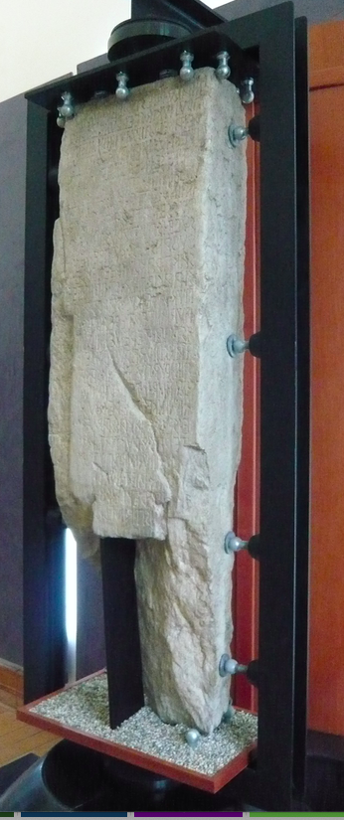
Cippus Abellanus c. 100 BCE
B 3-11
… [puf] herekleís fíísnú mefi[ú] íst, ehtrad feíhúss pú[s] herekleís fíísnam amfr- et pert víam pússtís, paí íp íst pústin slagím,
senateís suveís tangi- núd tríbarakavúm lí- kítud.
‘where the temple of Hercules is in the middle, outside the walls which surround the temple of Hercules, up to the road, which is there, within the boundary (?), by the decision of the senate, it is permitted to build’
CIL I² 698 13-15
Eisdem ostium, introitu in area quod nunc est, et
fenestras, quae in pariete propter eam aream sunt, pariete{m} opstruito
‘He shall also block up the doorway which now forms an entrance into the building space and also wall up the windows which are in the wall along the said vacant space.’

Slide 16
Cippus Abellanus c. 100 BCE
B 3-11
íním íúk tríba- rakkiuf pam núvlanús tríbarakattuset íním úíttiuf núvlanúm estud.
‘And any building which the Nolans build and its usemust belong to the Nolans.’
CIL I² 587 24-6
itemque eis uiatoribus praeconibus, quei ex hac lege lectei erunt, uicarium dare subdere ius esto licetoque
‘And it is to be right and lawful for those messengers and criers, who shall have been chosen according to this statute, to appoint or substitute a deputy’

Slide 17
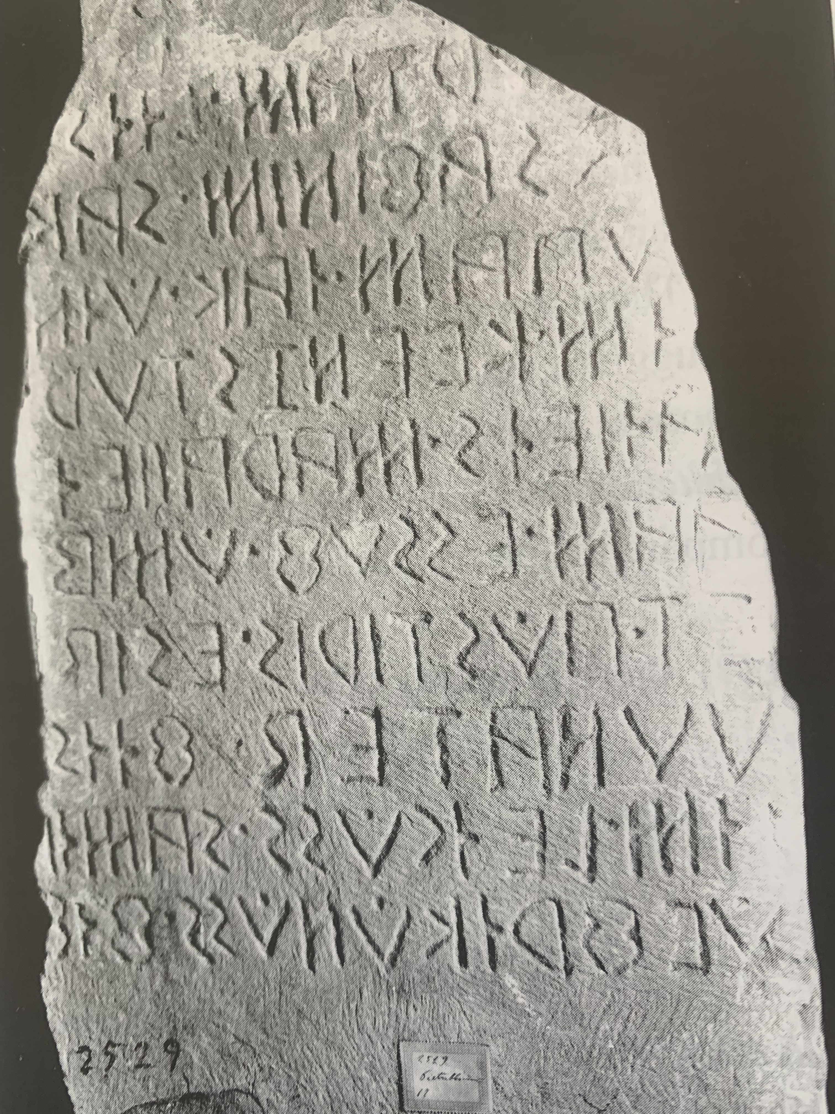
Oscan preposed relatives? Teruentum 8-10 c. 125 BCE 7-8
-?? trííbúm] paam essuf úmbn[ -??
ía]k trííb[úm -?? -] avt. pústiris. esidu[m -??- ]kúlú[m]
… the building] which he himself …[ ….
… tha]t building [ …] … or later the same man… […

Slide 18
Oscan preposed relatives? Teruentum 8-10 c. 125 BCE 7-8
-?? trííbúm] paam essuf úmbn[ -??
ía]k trííb[úm -?? -] avt. pústiris. esidu[m -??- ]kúlú[m]
… the building] which he himself …[ ….
… tha]t building [ …] … or later the same man… […
NB possible case of correlative izic/íúk/ídík (= is ea id) + noun
Only other examples in Pompei 24, Tabula Bantina and Cippus Abellanus

Slide 19
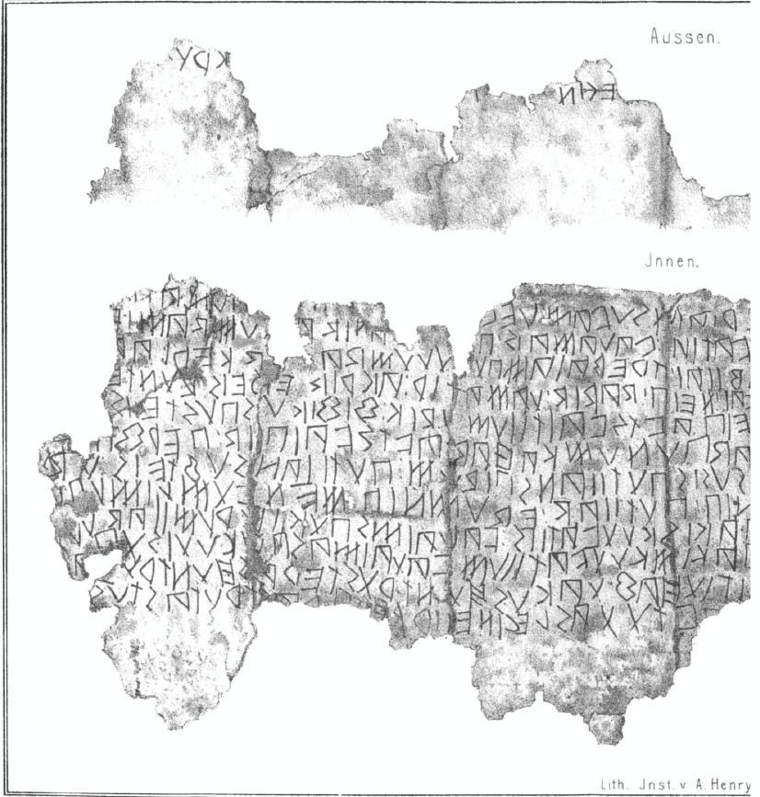
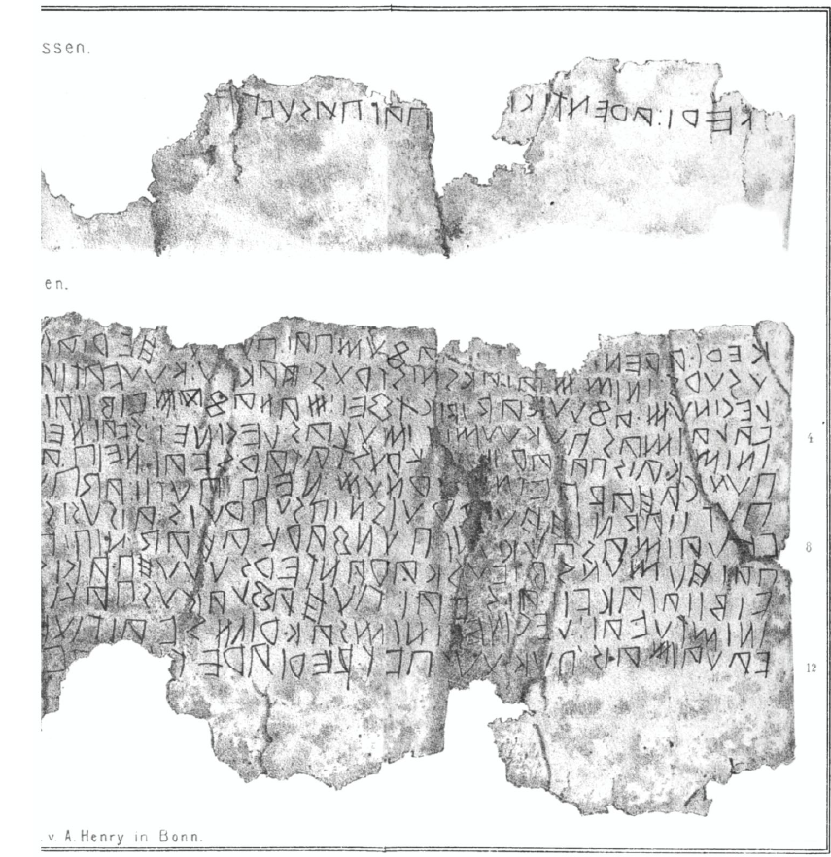
Capua 34 / Cp 37 300-150 BCE
B (outside)
Keri: arentika[i] pai pui suvam h[eriam suvam l]eginum […
‘To Ceres Arentikú, for her own [will her] own band..’

Slide 20
Capua 34 / Cp 37 300-150 BCE
B (outside)
Keri: arentika[i] pai pui suvam h[eriam suvam l]eginum […
‘To Ceres Arentikú, for her own [will her] own band..’
A 1 (inside)
Keri: arent[ikai: man]afum pai: pu[i pu]i heriam suvam leg[inum
‘To Ceres Arentikú I have entrusted, who , with respect to her own will, her own band I shall invoke’

Slide 21
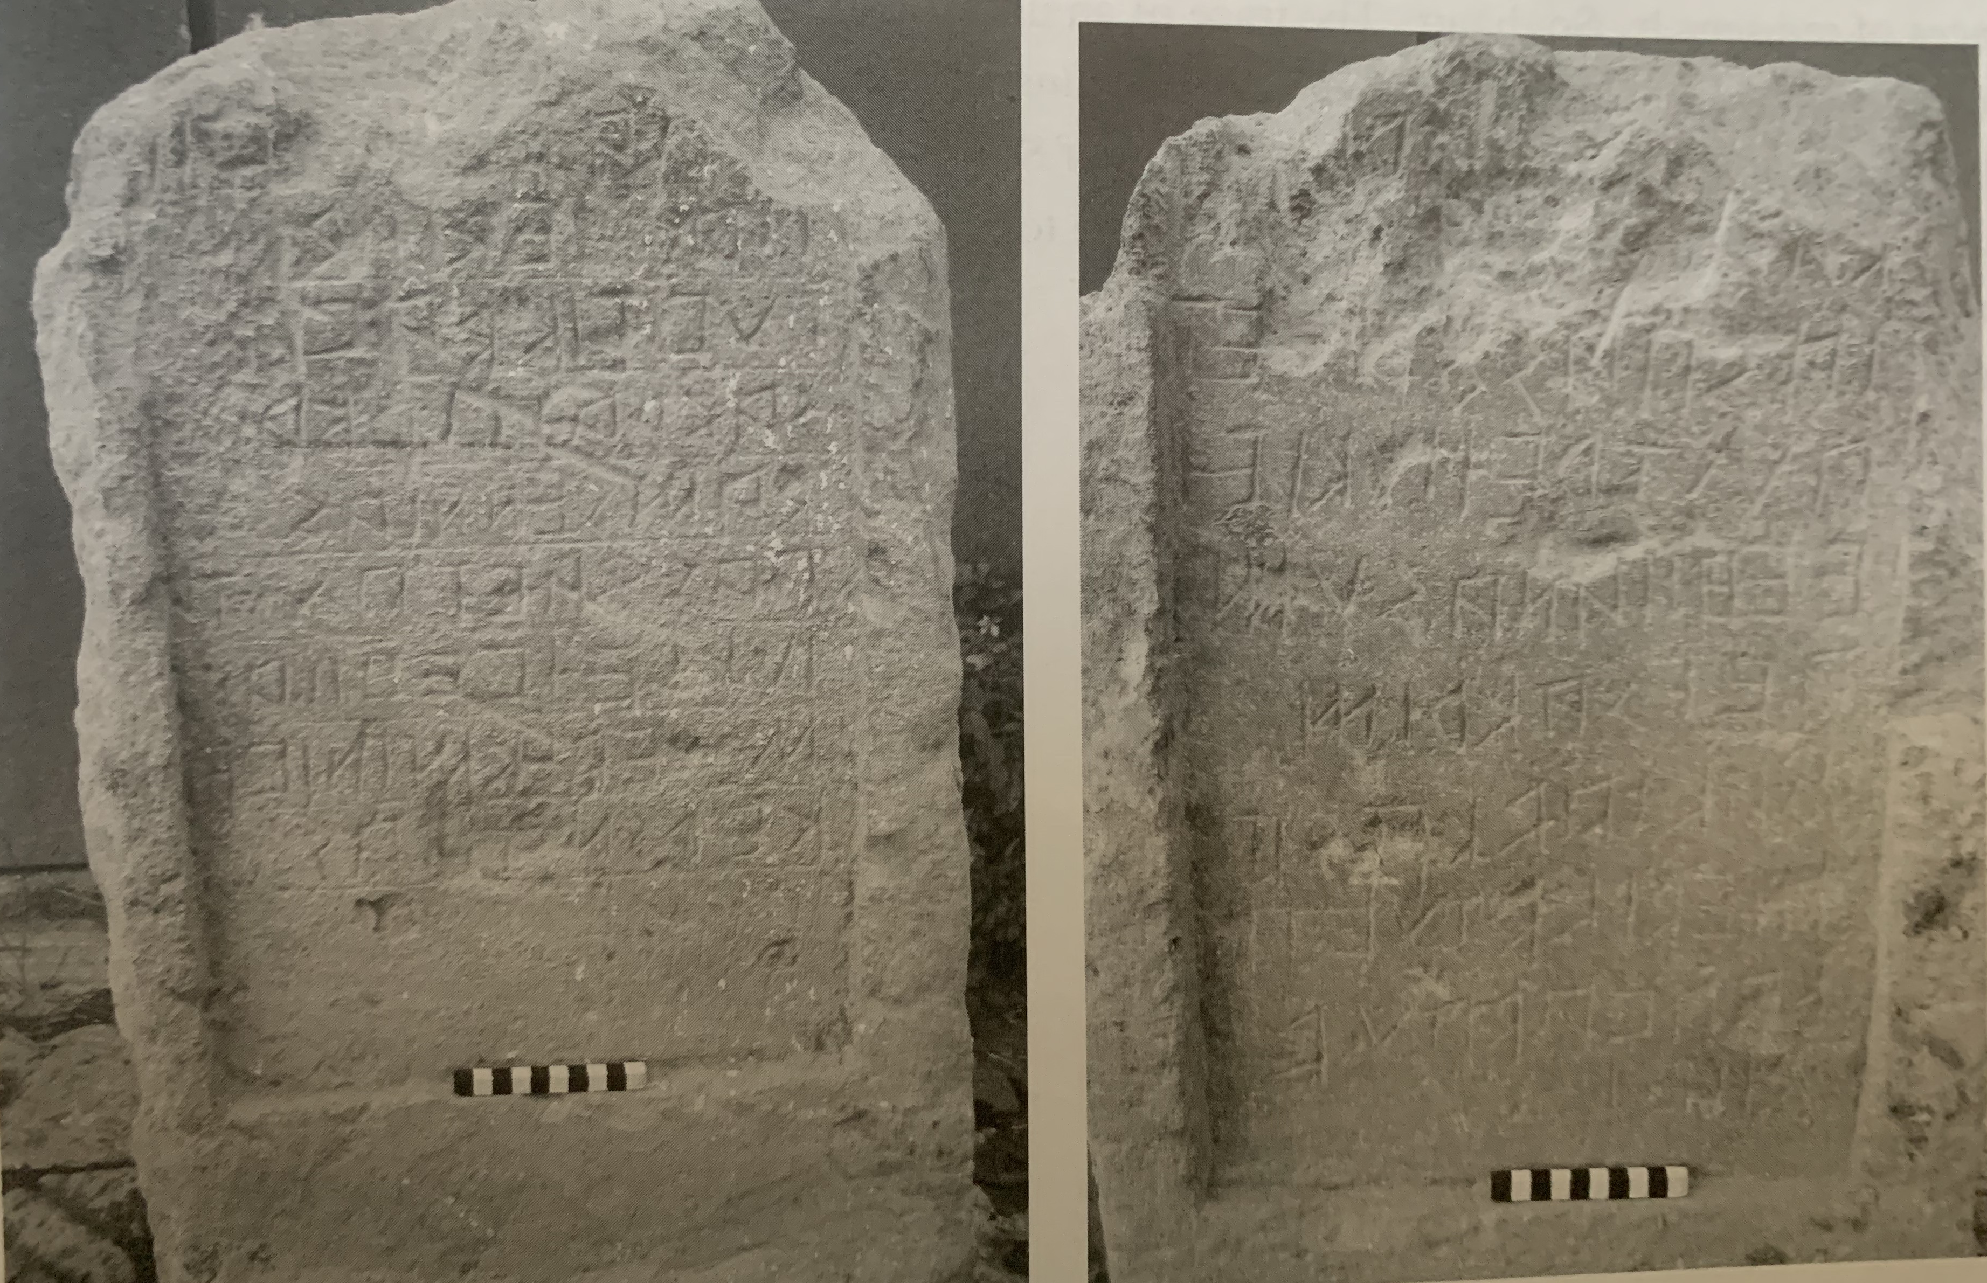
Capua 24 / Cp 33-34, early 3rd c BCE?
A
]k(ieís) pak(ieís) … viiúm
pak(ieís) medikid
túvtik(ud) kapv(anud)
sakraítir. ka(sit)
damsennias
pas. fiíet. pústr(eí)
iúkleí vehiian(asúm)
m edik(id). minive
kersna[s]ias
B
[ ??]
sak]ra[ít]ir.
kas[it dam]s[en]n-
ias. pas. fií et.
pústreí. iúkleí
<v>ehiianasúm
a<v>t. sakrim
fakiíad kasit
medik(i)d. túvtik(ud)
minive
kersnasias
kapv(anud), adpúd
fiíet
(B) ‘Of Dec. and Pac. Calauii; it is necessary that there be
a consecration; (the occasion is) the damothoiniai
which take place on the day after the Vehianae; but it is
necessary that one sacrifice a victim under the office
of the meddix tuticus at Capua until they take place.’

Slide 22
Capua 25 / Cp 30 early 3rd century BCE (?)
ek(úk). iúvil(ú). s(e)p(ieís)
kalúvieis. ini-
m. fratrúm
múinik(ú). est
fiísiais. púm-
periais. pas. pr-
aí. mamerttia-
is. set. sakrasia-
s. l. pettieis. me-
ddikkiai. fuf-
ens
‘This iúvilú is common to Sepis Kalúviis and his brothers, on the festival of the Nones which is before (the Nones) of March, there were sacrifices in the meddiss-ship of L. Pettiis.

Slide 23
Anxia 1 / Lu 39 300-250 BCE
πωτ ϝολ-
λοhομ. σορο-
ϝομ ειν(ειμ) καπιδιτ
ωμ. καhας λεικειτ κω-
[ρο μ]αχερηι λιο{κα}κειτ σϝα-
[ι τιω]μ εσοτ βρατωμ μειαι
ανα[fακ-]
‘Die Inschrift ist bis auf einzelne Wörter, wie ειν = et, λεικειτ = licet, εσοτ = eo mir unverständlich.’ Mommsen 1850 Die unteritalischen Dialekte p. 191

Slide 24
Anxia 1 / Lu 39 300-250 BCE
πωτ ϝολ-
λοhομ. σορο-
ϝομ ειν(ειμ) καπιδιτ
ωμ. καhας λεικειτ κω-
[ρο μ]αχερηι λιο{κα}κειτ σϝα-
[ι τιω]μ εσοτ βρατωμ μειαι
ανα[fακ-]
‘What ???, ??? and ??? it is proper for you (the passer-by) to take, [the monument] stands out for Machaireus (?) if you offer this favour to my [psyche (?)-?-]’

Slide 25
Anxia 1 / Lu 39 300-250 BCE
πωτ ϝολ-
λοhομ. σορο-
ϝομ ειν(ειμ) καπιδιτ
ωμ. καhας λεικειτ κω-
[ρο μ]αχερηι λιο{κα}κειτ σϝα-
[ι τιω]μ εσοτ βρατωμ μειαι
ανα[fακ-]
‘What ???, ??? and ??? it is proper for you (the passer-by) to take, [the monument] stands out for Machaireus (?) if you offer this favour to my [psyche (?)-?-]’
But εσοτ (neuter) cannot agree βρατωμ (feminine)!

Slide 26
Anxia 1 / Lu 39 300-250 BCE
πωτ ϝολ-
λοhομ. σορο-
ϝομ ειν(ειμ) καπιδιτ
ωμ. καhας λεικειτ κω-
[ρο μ]αχερηι λιο{κα}κειτ σϝα-
[ι τιω]μ εσοτ βρατωμ μειαι
ανα[fακ-]
‘What ???, ??? and ??? it is proper for you (the passer-by) to take, [the monument] stands out for Machaireus (?) if you offer this favour to my [psyche (?)-?-]’
But εσοτ (neuter) cannot agree βρατωμ (feminine)!
Is εσοτ a different correlative pronoun?

Slide 27
Umbrian Tabulae Iguvinae

Slide 28
Attractio inversa in Umbrian?
VIa 19f written in Latin script
uasor. uerisco. treblanir.
porsi. ocrer. pehaner. paca. ostensendi.
eo. iso. ostendu. pusi. pir. pureto. cehefi. dia.
‘The vessels at the Trebulan Gate
which shall be exhibited for the purification of the mount,
he shall exhibit them so that it might be given that fire might be taken from fire.’

Slide 29
Attractio inversa in Umbrian?
VIa 19f written in Latin script
uasor. uerisco. treblanir.
porsi. ocrer. pehaner. paca. ostensendi.
eo. iso. ostendu. pusi. pir. pureto. cehefi. dia.
‘The vessels at the Trebulan Gate
which shall be exhibited for the purification of the mount,
he shall exhibit them so that it might be given that fire might be taken from fire.’
NB
1) uasor marked as nom. plural although actually a neuter noun

Slide 30
Attractio inversa in Umbrian?
VIa 19f written in Latin script
uasor. uerisco. treblanir.
porsi. ocrer. pehaner. paca. ostensendi.
eo. iso. ostendu. pusi. pir. pureto. cehefi. dia.
‘The vessels at the Trebulan Gate
which shall be exhibited for the purification of the mount,
he shall exhibit them so that it might be given that fire might be taken from fire.’
NB
1) uasor marked as nom. plural although actually a neuter noun
2) porsi is an uninflected relativiser, used when the case of the relative is different to that of the head noun

Slide 31
Attractio inversa in Umbrian?
VIa 19f written in Latin script
uasor. uerisco. treblanir.
porsi. ocrer. pehaner. paca. ostensendi.
eo. iso. ostendu. pusi. pir. pureto. cehefi. dia.
‘The vessels at the Trebulan Gate
which shall be exhibited for the purification of the mount,
he shall exhibit them so that it might be given that fire might be taken from fire.’
NB
1) uasor marked as nom. plural although actually a neuter noun
2) porsi is an uninflected relativiser, used when the case of the relative is different to that of the head noun
3) eo is neuter plural nom./acc. (cognate with is ea id) with no repetition of the head noun (which does not happen in Umbrian).

Slide 32
Relative clauses in South Picene
Interamna Praetuttiorum1 / Sp TE 5 5th c BCE
σidom⁝ safinús⁝ estuf⁝ eσelsít⁝ tíom⁝ po
vaisis⁝ pidaitúpas⁝ fitiasom⁝ múfqlúm⁝ meí
t{t}istrúí⁝ nemúneí⁝ praistaít⁝ panivú⁝ meitims⁝ saf
inas⁝ tútas⁝ trebegies⁝ titúí⁝ pra[i]staklasa⁝ posmúi⁝
‘On this side (?), the Sabines erect (?) here, you (ACC), [-?-] (in
respect of) anything you have decreed (?), a monument (?) of
(your) deeds (?) stands out for [-?-] [-?-] the gift (?) of the Sabine
community for Titus (son) of Trebecius, for whom the (?) stele (is)’.

Slide 33
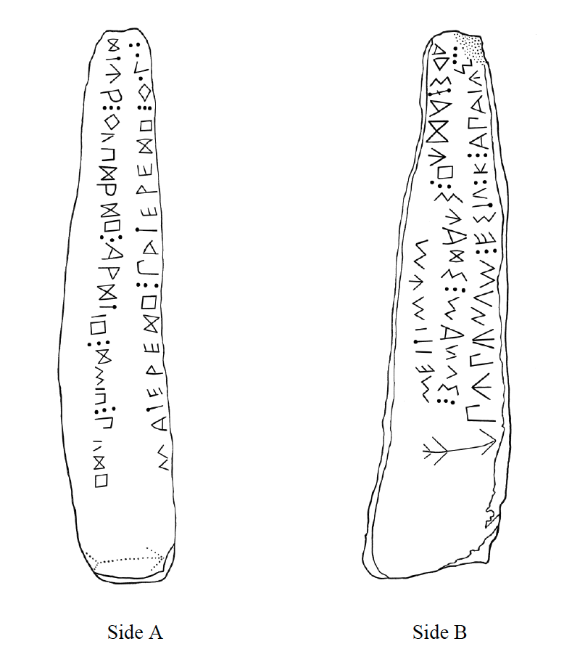
Asculum Picenum 2 /
Sp AP 2 (c. 500 BCE)
A matereíh⁝ patereíh⁝ qolof/ítúr⁝ qupíríh⁝ arítih⁝ ímih⁝ puíh
B púpúnum⁝ estufk⁝ apaiús⁝ adstaíúh⁝ súaís⁝ manus⁝ meitimúm
‘The Appaei belonging to the Poponii have set up here with their hands the gift (?) which is erected well, with art [-?-] for the mother (and) for the father’

Slide 34
Some Conclusions:
Oscan adnominal relatives follow their head noun
Oscan seems to avoid the Latin type qui ager … in eo agro ...
iii) Correlative izic / íúk / ídík + noun is not found in older texts
iv) Word order in Pompei 24 doesn’t the discourse functions that similar word
orders in Latin legal texts have.

Slide 35
References
Adams, J.N. & Nigel Vincent (eds.) (2016) Early and Late Latin: Continuity or Change? Cambridge, 390-419
Buck, Carl D. (1928) Grammar of Oscan and Umbrian, Boston
Crawford, Michael et al. (2011) Imagines Italicae, Oxford
Dupraz, Emmanuel (2009) Stratégies de relativisation dans les langues sabelliques. Bulletin de la Société de Linguistique de Paris 104, 215–58
Dupraz, Emmanuel (2011) Sabellian demonstratives: forms and functions. Leiden / Boston
Halla-aho, Hilla (2016) Left-detached constructions from early to late Latin. In Adams & Vincent, 367-389
Halla-aho, Hilla (2018) Left-dislocation in Republican Latin. (Amsterdam Studies in Classical Philology 28). Leiden
McDonald, Katherine (2012) The Testament of Vibius Adiranus. Journal of Roman Studies 102, 40-55
McDonald, Katherine (2022) Italy before Rome: A Sourcebook. Abingdon / New York
Pinkster, Harm (2021) The Oxford Latin Syntax. Volume II, Oxford
Probert, Philomen, & Eleanor Dickey (2016) Six notes on Latin correlatives. In Adams & Vincent, 390-419.
Väänänen, Veikko (1981) Introduction au latin vulgaire, 3rd ed. Paris
Vetter, Emil (1953) Handbuch der italischen Dialekte, Heidelberg
Watkins, Calvert (1995) How to Kill a Dragon: Aspects of Indo-European Poetics, Oxford
Zair, Nicholas (2016) Oscan in the Greek Alphabet, Cambridge
Zamponi, Raoul (2021) South Picene, London

