Slide 1
Decoding what the sender did not want to transmit.
Information technology and historical data; or something.
Manfred Thaller, Brühl
June 5th, 2018
Lausanne, COMHUM 2018

Slide 2
1. Fondly looking at my past - Clio / Κλειω

Slide 3
Fondly looking at my past - Clio / Κλειω
1978: Max-Planck-Institute for History, Göttingen
“Protoindustry” research – why did Europe’s population explode in the 17th / 18th century?
Part of the answer might be, that due to new modes of agricultural as well as proto-industrial production the need for a large labour force increased, so, among others:
postnatal population control was relaxed.
stigma of illegitimacy was reduced.

Slide 4
Fondly looking at my past - Clio / Κλειω
1978: Envisaged research instrument for 4 projects: Enriched “family reconstitutions”.
Take registers of births, marriages and depths and create complete genealogical links for village / small down.
Take all other sources – registers of taxation, protocols of local courts, wills, etc. – and connect the references to individuals to the result of step one.
Do all sorts of wonderful things.

Slide 5
Fondly looking at my past - Clio / Κλειω
1978: All sorts of wonderful things …
Are there differences in the demographic behaviour of families, where the produce mentioned in a probate inventory shows a different stage in the modernization of agricultural technologies?
Did the language used in the protocols of court sessions on illegitimate births change synchronously with agricultural / proto industrial development?
…

Slide 6
Fondly looking at my past - Clio / Κλειω
1978: Do not think small.
Let’s build a system that applies all possible computer based tools to all sorts of historical sources.

Slide 7
Fondly looking at my past - Clio / Κλειω
Highly irregular structures
  Fields of extremely varying length
  Many fields are missing
  Groups of fields are frequently, but irregularly often, repeated
  Hierarchies vary considerably in depths
Data bases are usually "large"
Data have complex semantics
  Non decimal currency systems
  A field might denote a calendar date; unless it should be a text.
  Sources are frequently ambiguous, vague or contradictory. Databases have to reflect that.

Slide 8
Highly irregular structures – data
<item> … smallest unit, can have more than one datatype simultaneously.
<aspect> … { basic item, comment item, original item }.
<element> … array of arbitrarily many items with aspects.
[ Similar to an “attribute” or a “terminal node”]
<group> … an array of arbitrarily many elements plus an array of arbitrarily many groups.
[ Similar to a “record” or a “non terminal node” ]
Yes, that is convenient for hierarchies.
No, this is a graph oriented, not a hierarchical data model: items can be of datatype “link”.

Slide 9
Fondly looking at my past - Clio / Κλειω
Highly irregular structures
  Fields of extremely varying length
  Many fields are missing
  Groups of fields are frequently, but irregularly often, repeated
  Hierarchies vary considerably in depths
Data bases are usually "large"
Data bases have complex semantics
  Non decimal currency systems
  A field might denote a calendar date; unless it should be a text.
  Sources are frequently ambiguous, vague or contradictory. Databases have to reflect that.

Slide 10
Vagueness at Item Level
Every item has a status.
They can be flagged as “dubious” – “?” – or outstanding – “!”.

Slide 11
Vagueness at Item Level - Numbers
Numbers – like 1, 1.5, 12.4.2, 3guilders – are intervals:
Number x ::= [Min(x)] _ [Max(x)]
Numbers can be fuzzified:
“circa 3guilders”
“less 3guilders _ 5guilders”

Slide 12
Vagueness at Item Level – Fuzzified Numbers
“circa [Min] _ [Max]”
“( [Min] - ( [Min] * 0.10) ) _ ( [Max] + ( [Max] * 0.10) )”
“circa greater [Min] _ [Max]”
➔“( [Min] - ( [Min] * 0.05) ) _ ( [Max] + ( [Max] * 0.10) )”

Slide 13
Vagueness at Item Level – Fuzzified Numbers
“<no fuzzifier> [Min] _ [Max]” ➔ “[Min] _ [Max]”
“equal [Min] _ [Max]” ➔ “[Min] _ [Max]”
“circa [Min] _ [Max]” ➔ “( [Min] - ( [Min] * 0.10) ) _ ( [Max] + ( [Max] * 0.10) )”
“greater [Min] _ [Max]” ➔ “[Min] _ ( [Max] + ( [Max] * 0.10) )”
“less [Min] _ [Max]” ➔ “( [Min] - ( [Min] * 0.10) ) _ [Max]”
“equal circa [Min] _ [Max]” ➔ “( [Min] - ( [Min] * 0.05) ) _ ( [Max] + ( [Max] * 0.05) )”
“equal greater [Min] _ [Max]” ➔ “[Min] _ ( [Max] + ( [Max] * 0.05) )”
“equal less [Min] _ [Max]” ➔ “( [Min] - ( [Min] * 0.05) ) _ [Max]”
“circa greater [Min] _ [Max]” ➔ “( [Min] - ( [Min] * 0.05) ) _ ( [Max] + ( [Max] * 0.10) )”
“circa less [Min] _ [Max]” ➔ “( [Min] - ( [Min] * 0.10) ) _ ( [Max] + ( [Max] * 0.05) )”
“equal circa greater [Min] _ [Max]” ➔ “( [Min] - ( [Min] * 0.025) ) _ ( [Max] + ( [Max] * 0.10) )”
“equal circa less [Min] _ [Max]” ➔ “( [Min] - ( [Min] * 0.10) ) _ ( [Max] + ( [Max] * 0.025) )”

Slide 14
Vagueness at Item Level – Fuzzified Numbers
Comparing two numbers – A and B - we have to compare
[Min(A)] – [Max(A)] with [Min(B)] – [Max(B)]
“A greater B” ➔ “[Min(A)] > [Max(B)]”
“A equal greater B” ➔ “[Min(A)] >= [Max(B)]”
“A circa greater B” ➔ “[Max(A)] >= [Min(B)]”
“A equal circa greater B” ➔ “[Max(A)] >= [Max(B)]”

Slide 15
Vagueness at Item Level – Fuzzified Numbers
Arithmetic operations:
“R = A + B” ➔ “[Min(R)] = [Min(A)] + [Min(B)]” and “[Max(R)] = [Max(A)] + [Max(B)]”
“R = A - B” ➔ “[Min(R)] = [Min(A)] - [Min(B)]” and “[Max(R)] = [Max(A)] – [Max(B)]”
“R = A * B” ➔ “[Min(R)] = [Min(A)] * [Min(B)]” and “[Max(R)] = [Max(A)] * [Max(B)]”
“R = A / B” ➔ “[Min(R)] = [Min(A)] / [Min(B)]” and “[Max(R)] = [Max(A)] / [Max(B)]”

Slide 16
Vagueness at Element (≈ Attribute) Level
Every element can have:
A visibility in the unit interval [0,1]
Alternative views
…/1=patronymic=3=surname=7=spurious=Johansen/…

Slide 17
Vagueness at Group (≈ Record) Level
Every group can have:
A visibility in the unit interval [0,1]
Alternative views
1=defendant/3=witness/7=spurious$

Slide 18
2. On Historical Information

Slide 19
1948: Claude Shannon
Information
Source Transmitter Receiver Destination
Signal Received
Signal
Message Message
Noise
Source

Slide 20
Knowledge Pyramid
Wisdom
Knowledge
Information
Data

Slide 21
Data, Information, Knowledge
Data can be stored: “22°C”.
Information are data in a commonly understood context: "In this lecture hall there is a temperature of 22°C".
Knowledge allows actions based on an individualized context: “For me this means I’ll be more comfortable, if I get out of my jacket.”

Slide 22
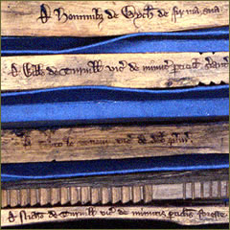
Information

Slide 23
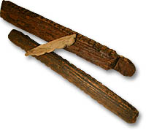
Data

Slide 24
Knowledge
Application by cognitive agent
Information
Interpretation by cognitive agent
Data

Slide 25
Data, Information, Knowledge
(1) Cognitive agents interpret data within a context common to all agents.
„ In this lecture hall there is a temperature of 22°C“.
(2) Cognitive agents apply information within a context which is specific to the individual agent.
„For me this means I’ll be more comfortable, if I get out of my jacket.”

Slide 26


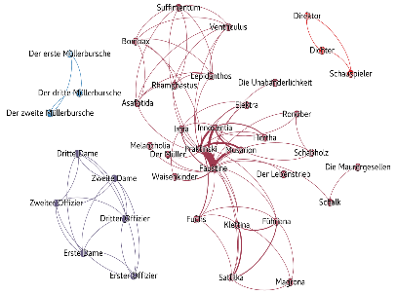
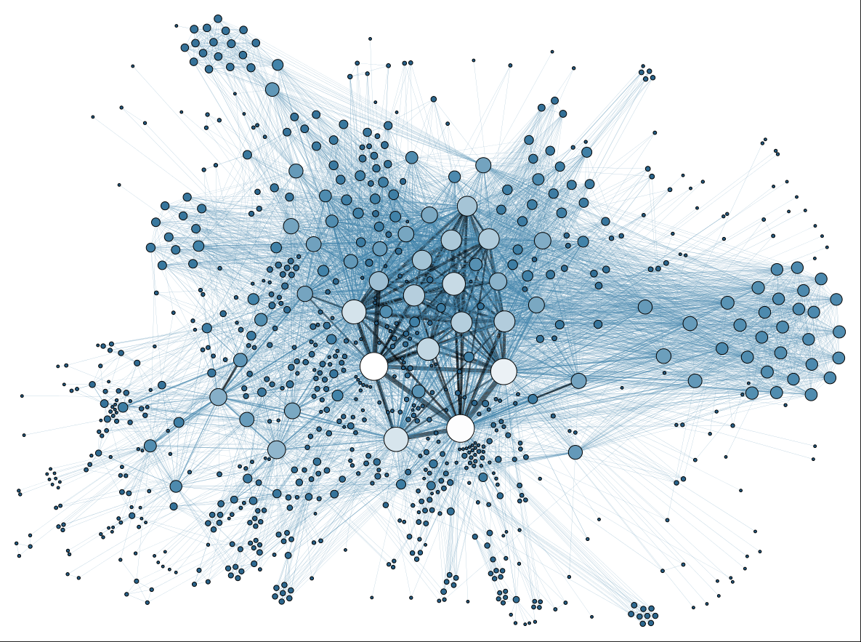
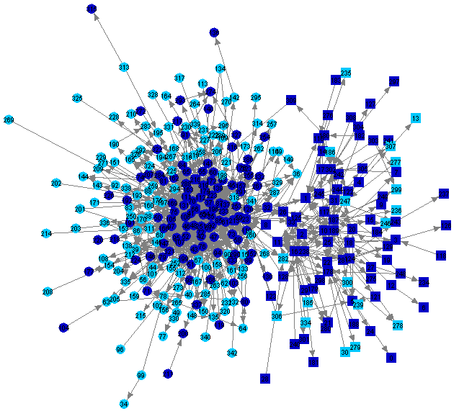
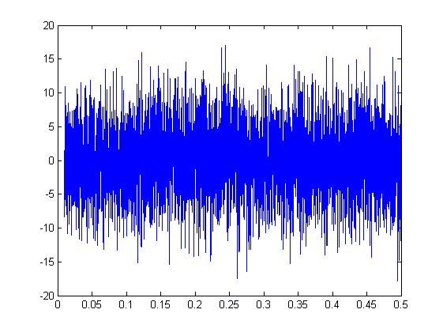
Data, Information, Knowledge ➔ Contemporary
Context
Knowledge
Knowledge
Information
5 €
Signal
(Noise)
5 €
Information
Data
10011…
10011…
Data

Slide 27
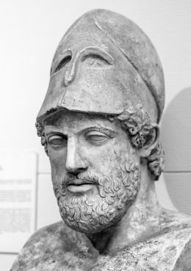
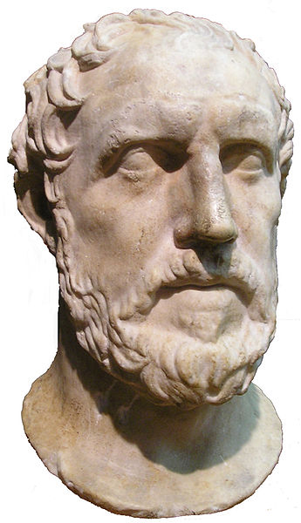
Data, Information, Knowledge ➔ Historical
Context
Knowledge
Knowledge
Information
πόλεμος
Signal
(Noise)
πόλεμος
Information
Data
10011…
10011…
Data

Slide 28
Data, Information, Knowledge ➔ Hist. Research
Context
Knowledge
Knowledge
Information
πόλεμος
Signal
(Noise)
πόλεμος
Information
Data
10011…
10011…
Data

Slide 29
Data, Information, Knowledge ➔ Hist. Research
Context
?
?
Knowledge
Knowledge
Information
πόλεμος
Signal
(Noise)
πόλεμος
Information
Data
10011…
10011…
Data

Slide 30

Data, Information, Knowledge ➔ Hist. Research
Context
?
?
Knowledge
Knowledge
Information
πόλεμος
Signal
(Noise)
πόλεμος
Information
Data
10011…
10011…
Data

Slide 31
1948: Claude Shannon
Information
Source Transmitter Receiver Destination
Signal Received
Signal
Message Message
Noise
Source

Slide 32
The observer / interpreter model
Information
Source Transmitter Receiver Destination
Signal Received ……..
Signal
Message
Noise
Source Interpreter

Slide 33
The observer / interpreter model
Historians do not decode messages. They observe them, to learn about the context of the sender.

Slide 34
The observer / interpreter model
Some consequences:
Separate data (“uninterpreted”) sources and their interpretation as cleanly as possible.
No embedded markup.
Texts are sources, just as images and other data types.
➔Develop standoff markup that covers all those data types under a unified model.
Accept vagueness in all its appearances.

Slide 35
3. Vagueness and Fuzziness

Slide 36
Vagueness and Fuzziness - general
Some of the most important conceptual dimensions
Uncertainty I: A precise data point exists; but it is doubtful, whether it is correct - She was probably 25 years old.
Uncertainty II: One of a set of data points does apply – She was 25 or 35 years old.
Vagueness I: A data point is beyond doubt; but it is an interval, rather than a single value – She was born in her twenties (➔ 20 – 29 years old).
Vagueness II: A data point is expressed on a scale, on which a desired operation is undefined – She was young.
Inconsistency: Contradictory data points are supported - Some say, she was 25 years old; others say, she was 65.
Incompleteness: No concrete data point is known, though it must exist – Her age is unknown.

Slide 37
Vagueness and Fuzziness - general
Assumption: All of these can be supported by three technical solutions
Software support for fuzzy numbers.
Software support for fuzzy terms and structures.
Software support for fuzzy flow control.
All three supported by a general fuzzy logic.

Slide 38
Vagueness and Fuzziness - general
What does software support mean?
Solution on the level of an application – e.g. a data base “Spurious people of the 13th century”, <http://sp13c.someuniversity.terra> – means every other application to be developed, ever, has to reinvent the solution.
Solution on the level of an application system – e.g. a specific data base system like Neo4J – means every application realized in another application system to be developed ever, has still to reinvent the solution.
Solution on the level of a programming language – e.g. C++ or Java – means all applications realized with the help of any application system realized with the help of that programming language can easily use it.
[ The next level goes beyond the horizon of this presentation. ]

Slide 39
Vagueness and Fuzziness - general
fuzziness:
fuzzy
[fuhz-ee]
See more synonyms on Thesaurus.com
adjective, fuzz·i·er, fuzz·i·est.
…
indistinct; blurred: A fuzzy photograph usually means you jiggled the camera.

Slide 40
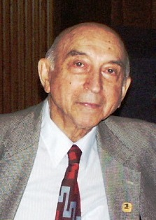
Vagueness and Fuzziness - general
Fuzziness:
A bundle of mathematical, logical and software engineering concepts to handle computations for a number of classes of uncertainty and vagueness, started by:
Lotfi A. Zadeh: “Fuzzy Sets”, Information and Control 8 (1965) 338-353.

Slide 41
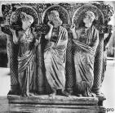
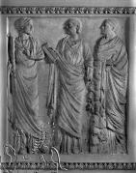
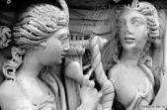
Crisp sets
Elements are contained within a set; or not
Set of three images of κλειω: M = { , , }
Set of all images of κλειω: K = { … }.

Slide 42
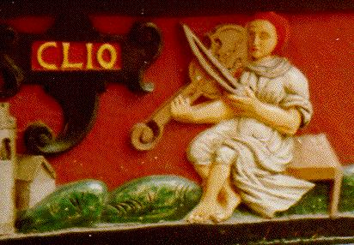
Problematic sets
Elements are contained within a set; or not
Set of three images of κλειω: M = { , , }
Set of all images of κλειω: K = { , … }.

Slide 43
Problematic sets
Elements are contained within a set; or not

Slide 44


Problematic sets
Elements are contained within a set; or not

Slide 45
Crisp sets in Fuzzy language
„There is a membership function μ() defining for every element e within a set U – Universe of Discourse – whether this element belongs to the set M{}.
E.g. μ(images of κλειω, e):
1.0 für ( , , )
0.0 für ( )

Slide 46
Fuzzy Sets
Why necessarily one and zero? – {0,1}
Why not the unit interval? – [0,1]
I.e.: Truth is not binary, but a “degree” between 0.0 and 1.0
a.k.a “Continuous truth function”.

Slide 47
Fuzzy Sets
E.g.: μ_{κλειω}(some sculptures)
U = some sculptures = { , , , }.
μ_{κλειω}(some sculptures) = (1.0, 1.0, 1.0, 0.3)
or rather
μ_{κλειω}(some sculptures) = (0.8, 0.9, 0.7, 0.3)

Slide 48
Fuzzy Sets ➔ Fuzzy Logic I
Equality of two sets: μ A (u) = μ B (u),∀ u∈U
Union: μ A∪B (u) = max[μ A (u),μ B (u)],∀ u ∈U
Intersection μ A∩B (u) = min[μ A (u),μ B (u)],∀ u∈U
Negation: μ −A (u) = 1−μ A (u),∀ u∈U

Slide 49
Fuzzy Sets ➔ Fuzzy Logic II
Therefore:
Collection = { , , , }.
μ_{κλειωExpert1}(collection) = (1.0, 1.0, 1.0, 0.3)
μ_{κλειωExpert2}(collection) = (0.8, 0.9, 0.7, 0.3)
μ_{κλειωExpert1} ∪ μ_{κλειωExpert2 =} (1.0, 1.0, 1.0, 0.3)

Slide 50
Fuzzy Sets ➔ Fuzzy Logic III
Union: μ A∪B (u) = max[μ A (u),μ B (u)],∀ u ∈U
But: ➔ A AND B ➔ min (A, B)
Intersection μ A∩B (u) = min[μ A (u),μ B (u)],∀ u∈U
But: ➔ A OR B ➔ max (A, B)

Slide 51
Fuzzy Sets ➔ Fuzzy Logic Logik VI
Therefore:
Object = { }.
μ_{κλειωExpert1}(collection) = (1.0, 1.0, 1.0, 0.3)
μ_{κλειωExpert2}(collection) = (0.8, 0.9, 0.7, 0.3)
if (object = κλειωExpert(object) AND object = κλειωExpert(object) ) …
Truth value used: 0.7

Slide 52
Linguistic Variables I
Technical height of a person: 173 cm.
Colloquial height of a person : { tiny, small, medium, large, enormous }

Slide 53
Linguistic Variables II
Colloquial height of a person: 173 cm.

Slide 54
Linguistic Variables III
Colloquial height of a person

Slide 55
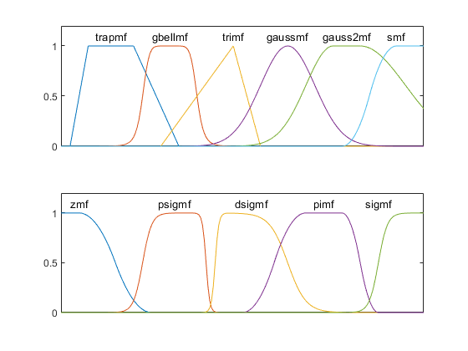
Linguistic Variables IV
https://de.mathworks.com/help/fuzzy/examples/membership-function-gallery.html

Slide 56


Linguistic Variables V
A linguistic variable represents a conceptual property, various linguistic (?) terms have in a measurable way.
In the literature e.g. „birdiness“ of:
{ eagle, dove, swallow, robin, penguin }
„κλειωness“ of { , , , }
if (κλειωness( ) > 0.5) …

Slide 57
Linguistic Variables VII / 1
FUZZY CalculateDiscount
{
IF shelf_time IS long THEN discount IS large
IF shelf_time IS short THEN discount IS low
IF shelf_life IS short THEN discount IS high
IF shelf_life IS Long THEN discount IS normal
IF quantity IS small THEN discount IS none
IF quantity IS large THEN discount IS large
IF quantity IS huge THEN discount IS high
IF customer IS new THEN discount IS special
IF customer IS recent THEN discount IS normal
IF customer IS longterm THEN discount IS large
IF shelf_life IS short AND
shelf_time IS long THEN discount IS deep
}

Slide 58
Linguistic Variables VII / 2
void main (void)
{
// . . . Application code to get crisp numbers for
// Cost Markup Shelf_time Shelf_life Payment
// Quantity Customer
CalculateDiscount ();
Quote = (cost + (cost * markup)) * ( 1.0 – (discount / 100.0));
}

Slide 59
Linguistic Variables ➔ Fuzzy Control
in-
put
out-
put
decision
logic
fuzzification
defuzzification
knowledge base

Slide 60
Vagueness and F/fuzziness – conceptual
Object | Grey Systems | Prob. statistics | Fuzzy math
Research objects | Poor information | Stochastics | Cognitive Uncertainty
Basic sets | Grey hazy sets | Cantor sets | Fuzzy sets
Methods | Information coverage | Mapping | Mapping
Procedures | Sequence Operator | Frequency Distribution | Cut set
Data requirement | Any distribution | Typical distribution | Known membership
Emphasis | Intension | Intension | Extension
Objective | Laws of reality | Historical laws | Cognitive expression
Characteristics | Small sample | Large sample | Experience
Sifeng Liu and Yi Lin: Grey Systems. Theory and Practical Applications, London, 2011, p. 11, table 1.2

Slide 61
Vagueness and F/fuzziness – conceptual
Object | Grey Systems | Prob. statistics | Fuzzy math
Research objects | Poor information | Stochastics | Cognitive Uncertainty
Basic sets | Grey hazy sets | Cantor sets | Fuzzy sets
Methods | Information coverage | Mapping | Mapping
Procedures | Sequence Operator | Frequency Distribution | Cut set
Data requirement | Any distribution | Typical distribution | Known membership
Emphasis | Intension | Intension | Extension
Objective | Laws of reality | Historical laws | Cognitive expression
Characteristics | Small sample | Large sample | Experience
Sifeng Liu and Yi Lin: Grey Systems. Theory and Practical Applications, London, 2011, p. 11, table 1.2

Slide 62
Vagueness and F/fuzziness – conceptual
Object | Grey Systems | Prob. statistics | Fuzzy math
Research objects | Poor information | Stochastics | Cognitive Uncertainty
Basic sets | Grey hazy sets | Cantor sets | Fuzzy sets
Methods | Information coverage | Mapping | Mapping
Procedures | Sequence Operator | Frequency Distribution | Cut set
Data requirement | Any distribution | Typical distribution | Known membership
Emphasis | Intension | Intension | Extension
Objective | Laws of reality | Historical laws | Cognitive expression
Characteristics | Small sample | Large sample | Experience
Sifeng Liu and Yi Lin: Grey Systems. Theory and Practical Applications, London, 2011, p. 11, table 1.2

Slide 63
Vagueness and F/fuzziness – conceptual
Object | Grey Systems | Prob. statistics | Fuzzy math
Research objects | Poor information | Stochastics | Cognitive Uncertainty
Basic sets | Grey hazy sets | Cantor sets | Fuzzy sets
Methods | Information coverage | Mapping | Mapping
Procedures | Sequence Operator | Frequency Distribution | Cut set
Data requirement | Any distribution | Typical distribution | Known membership
Emphasis | Intension | Intension | Extension
Objective | Laws of reality | Historical laws | Cognitive expression
Characteristics | Small sample | Large sample | Experience
Sifeng Liu and Yi Lin: Grey Systems. Theory and Practical Applications, London, 2011, p. 11, table 1.2

Slide 64
3.1 F/fuzzy numbers

Slide 65
Fuzzified Numbers
“R = A + B” ➔ “[Min(R)] = [Min(A)] + [Min(B)]” and “[Max(R)] = [Max(A)] + [Max(B)]”
A ::= “2 _ 5”
B ::= “4 _ 7”
“R = A + B” ➔ “[Min(R)] = 2 + 4” and “[Max(R)] = 5 + 7”
R ::= “6 _ 12”

Slide 66
Fuzzified Numbers
1
0 1 2 3 4 5 6 7 8 9 10 11 12 13 14
A =
B =
R =

Slide 67
Fuzzified Numbers - temporal
“R = A + B” ➔ “[Min(R)] = Min([Min(A)],[Min(B)])” and “[Max(R)] = Max([Max(A)], [Max(B)])”
A ::= “1502 _ 1505”
B ::= “1504 _ 1507”
“R = A + B” ➔ “[Min(R)] = Min(1502,1504)” and “[Max(R)] = Max(1505,1507)”
R ::= “1502 _ 1507”

Slide 68
Fuzzified Numbers - temporal
1
1500 1 2 3 4 5 6 7 8 9 10 11 12 13 14
A =
B =
R =

Slide 69
Fuzzified Numbers – corroboration
“R = A + B” ➔ “[Min(R)] = Min([Min(A)],[Min(B)])” and “[Max(R)] = Max([Max(A)], [Max(B)])”
A ::= “1502 _ 1505”
B ::= “1504 _ 1507”
“R = A + B” ➔ “[Min(R)] = Min(1502,1504)” and “[Max(R)] = Max(1505,1507)”
R ::= “1502 _ 1507”

Slide 70
Fuzzified Numbers - corroboration
1.0
0.5
1500 1 2 3 4 5 6 7 8 9 10 11 12 13 14
A =
B =
R =

Slide 71
FuzzNumber – a datatype
class FuzzNumber
{
private:
float min, max;
…
public:
FuzzNumber add(a,b,membershipFunction,semanticOrientation);
…
FuzzTruthValue compare(a,b,membershipFunction,semanticOrientation);
…
}

Slide 72
3.2 F/fuzzy structures / graphs

Slide 73
A semantic relationship ==
someNode
date:
source 1
date:
source 2
date:
source 3
date:
source 4

Slide 74
another semantic relationship.
someNode
author:
person 1
author:
person 2
author:
person 3
author:
person 4

Slide 75
A “fuzzy” / “Fuzzy” concept: co-edges
An interpreted text is a network of interpretative vertices connected by interpretative edges.
Vertices as well as edges can contain the text to be interpreted.
Any two vertices can be connected by n edges, the set of which for the purpose of this model we call co-edge.
The interpretative information assigned to an edge can contain two properties: (a) an assignment to an abstract class and (b) a relative weight.
Abstract classes are expressed by identifiers.
Relative weights are expressed as rational numbers.
The set of relative weights within a co-edge can be required to fulfill a constraint.
One possible constraint requires all relative weights of a co-edge to give a sum of 1.0, i.e., underpin a probabilistic interpretation.
Another one requires all relative weights of a co-edge to fulfill all criteria of a possibilistic interpretation.

Slide 76
A co-edge
someNode
last quarter 10th century
authority: A
weight: evaluate(authority)
saeculi X exeuntis
authority: B
weight: evaluate(authority)
10c (985-999)
authority: C
weight: evaluate(authority)
date

Slide 77
A semantic relationship !=
someNode
source 1
source 2
source 3
source 4
origDate

Slide 78
another semantic relationship.
someNode
author:
person 1
author:
person 2
author:
person 3
author:
person 4

Slide 79
3.3 F/fuzzy flow control

Slide 80
F/fuzzy flow control
Boolean if:
if (proposition() == 1) dosomething();
else dosomethingelse();
fuzzy if:
if (proposition() >= 0.5) dosomething();
else dosomethingelse();

Slide 81
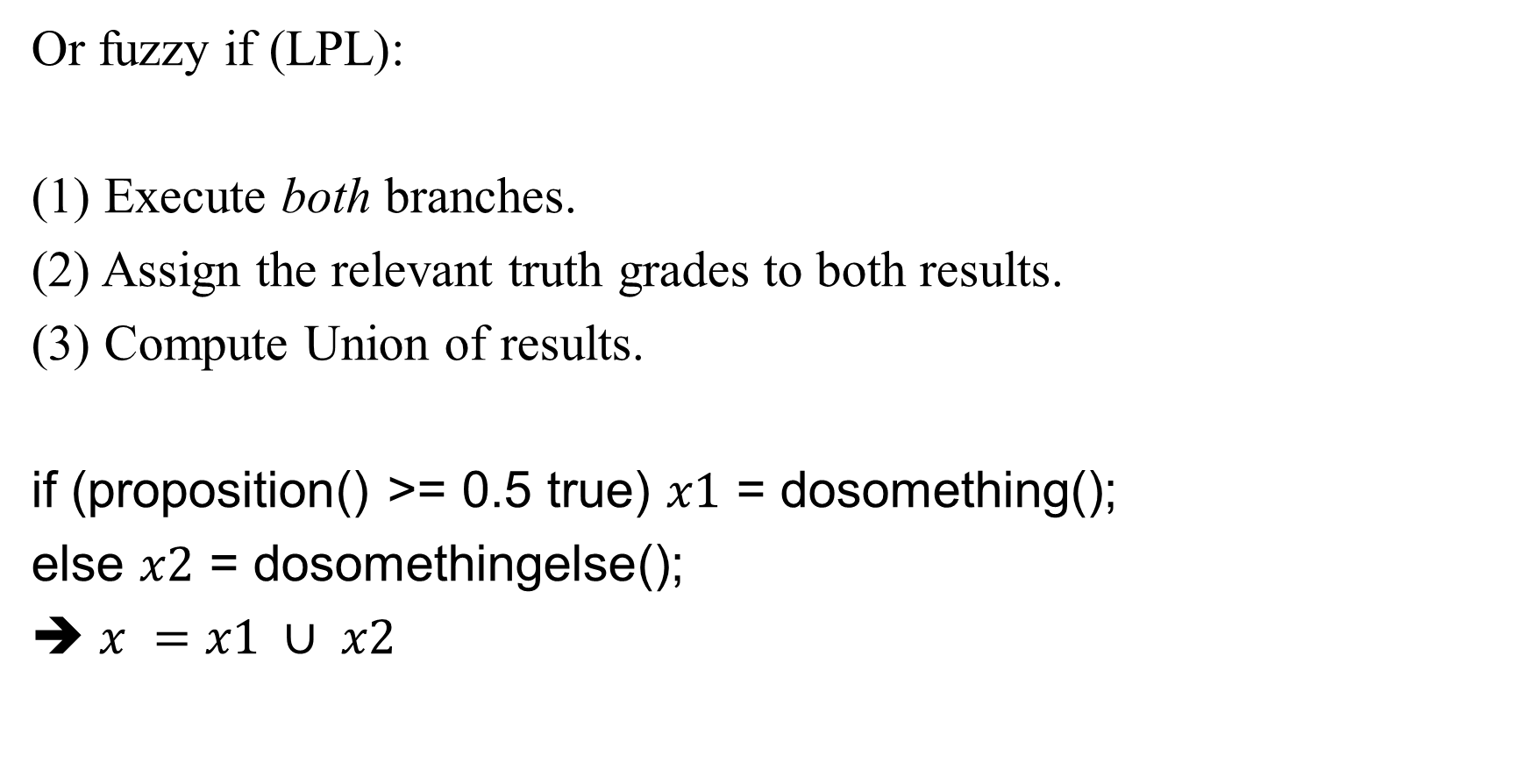
F/fuzzy flow control
Or fuzzy if (LPL):
(1) Execute both branches.
(2) Assign the relevant truth grades to both results.
(3) Compute Union of results.
if (proposition() >= 0.5 true) $x1$ = dosomething();
else $x2$ = dosomethingelse();
➔ $x =x1 ∪ x2$

Slide 82
Linguistic Variables ➔ Fuzzy Control
in-
put
out-
put
decision
logic
fuzzification
defuzzification
knowledge base

Slide 83
F/fuzzy flow control
Boolean if:
if (proposition() == 1) deleteobject();
else createobject();
fuzzy if:
???

Slide 84
Storing information as intermediate stage of a permanently running algorithm.
Manfred Thaller, Brühl
Do not worry; not today!

Slide 85
Thank you for your attention!
manfred.thaller@uni-koeln.de
IvoryTower.hypotheses.org

