Slide 1


Towards a quantitative research framework for historical disciplines
Barbara McGillivray
Giovanni Colavizza
Tobias Blanke
COMHUM 2018

Slide 2
Quantitative research and historical disciplines
Different scholarly communities, different reactions
Historical disciplines:
  closed corpora
  phenomena that change over time
  combine quantitative and qualitative methods
We propose a general methodological reflection

Slide 3
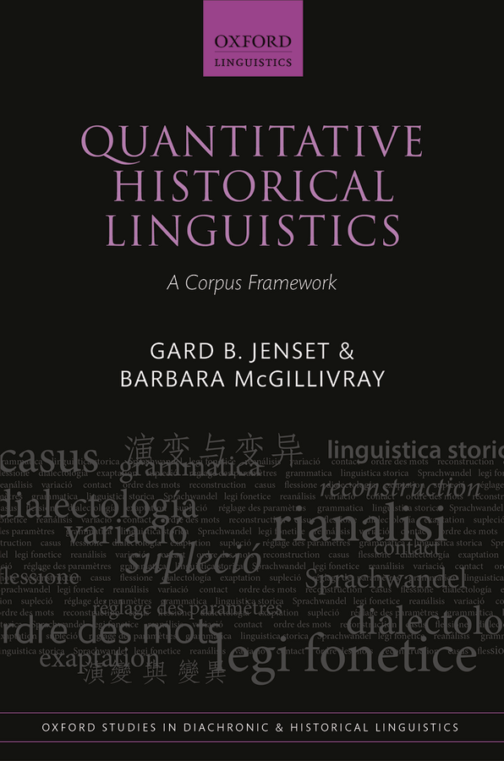
The starting point
The first and (so far) only general framework for historical linguistics
Inspired by Carrier (2012)

Slide 4
Quantitative historical linguistics
Assumptions
The linguistic historical reality is lost
aim of quantitative research: models of and claims on such reality, quantitatively driven from evidence and lead to consensus among the scholarly community
Scope
where quantifiable evidence can be gathered from primary sources
Jenset & McGillivray (2017: 45 ff.)

Slide 5
Quantitative historical linguistics
Claims
Statements based on evidence
Possess strength proportional to that of the evidence supporting them
Models
Formalized representations of a phenomenon (statistical or symbolic)
Research tools embedding claims or hypotheses
They produce novel claims and hypotheses
Jenset & McGillivray (2017: 45 ff.)

Slide 6
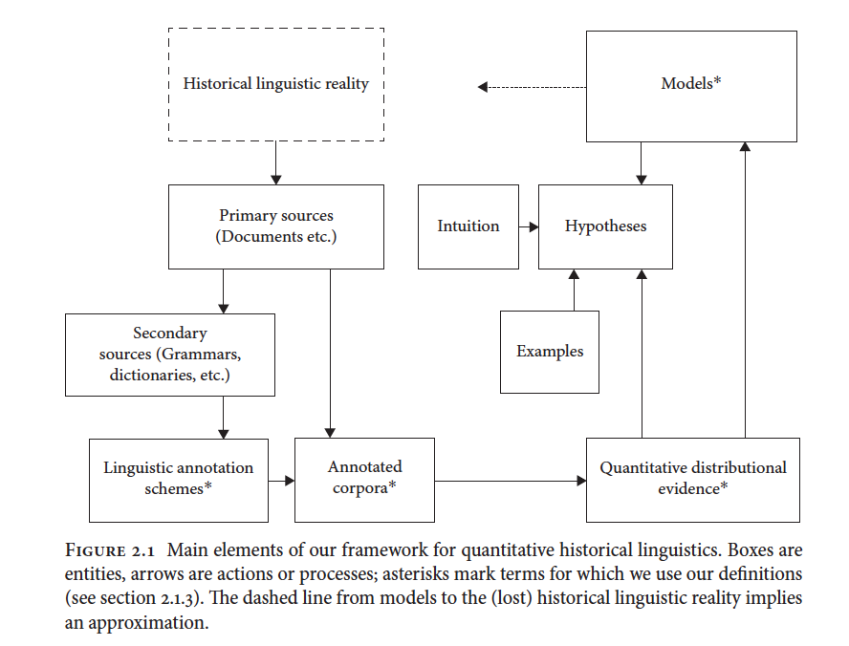
Quantitative historical linguistics: research workflow
Jenset & McGillivray (2017: 45)

Slide 7
Extension to historical disciplines
What happens with historical data and research?
What do we need to change?

Slide 8
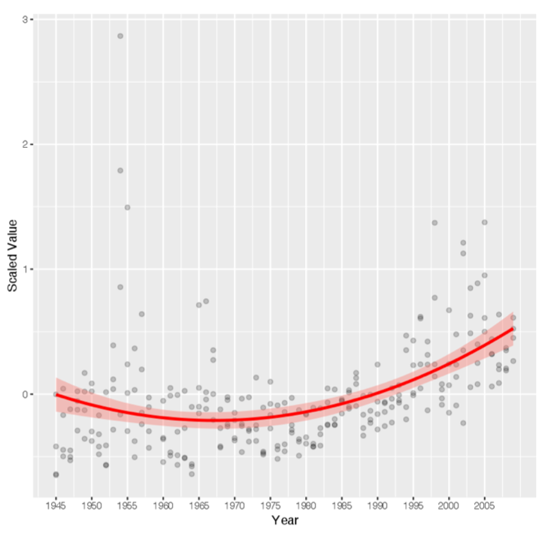
Case study 1 (Blanke and Wilson 2017)
UK Government White Papers from 1945 to 2010
888 documents with 19.3 million words in total
Mid-level abstraction, between theoretical debates by intellectuals and intellectually-minded politicians and laws, regulations, guidance documents, instructions and so on
In previous work we could automatically detect changes in meaning, but the epochs themselves were not machine-read

Slide 9
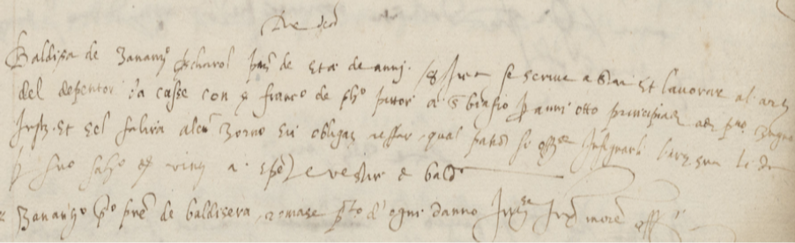
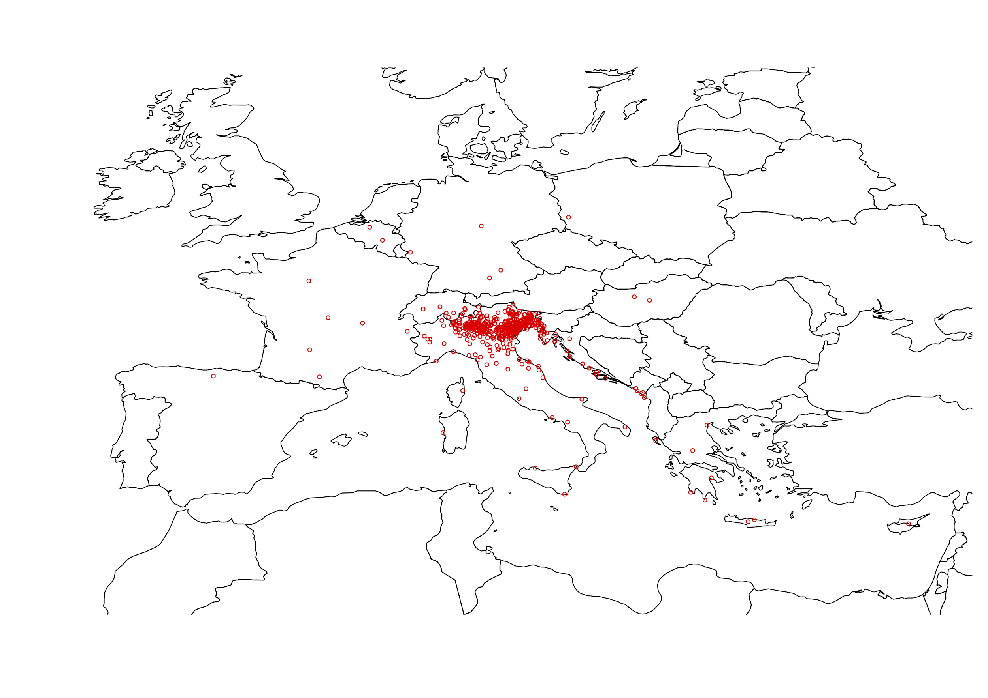
Case study 2: Apprenticeship in early modern Venice
~55000 contracts from the end of the XVIth century to mid XVIIIth.
Publicly registered to certify their successful completion in view of mastership and guild membership.
Results here based on a smaller sample
In collaboration with Maud Ehrmann, Riccardo Cella, Anna Bellavitis, Valentina Sapienza et al.

Slide 10
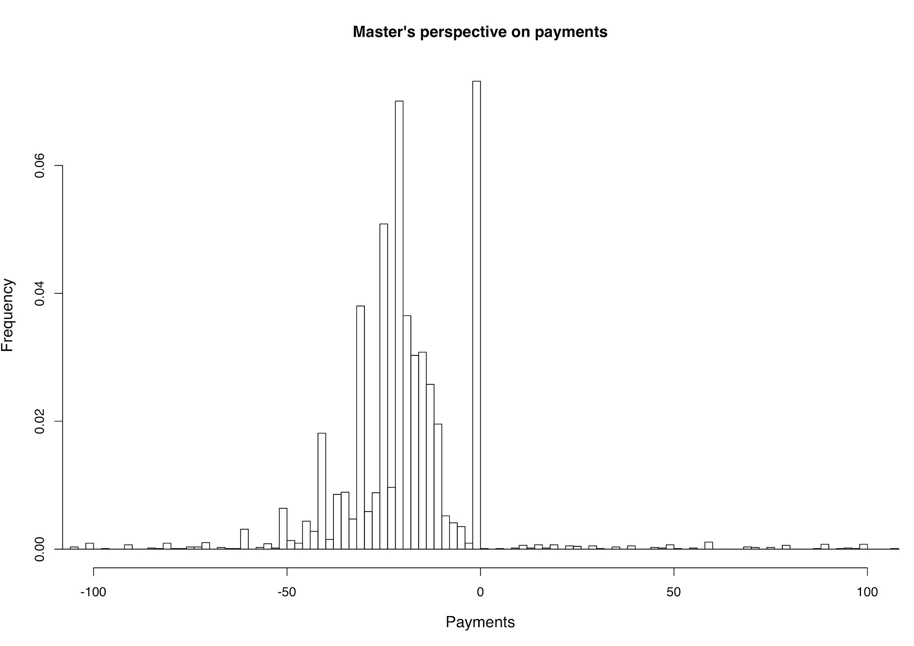
Case study 2: Apprenticeship in early modern Venice
Payments from/to master highlight an interesting 3-modal distribution:
Many apprentices receive a payment
Many do not
Some pay their master in turn
Question: what is happening? How is the apprenticeship used in practice?
Hypothesis: double-track system. You can pay to get more training, or you can be paid and act as cheap workforce. NB reality probably blurred!
In collaboration with Maud Ehrmann, Riccardo Cella, Anna Bellavitis, Valentina Sapienza et al.

Slide 11
Case study 2: Apprenticeship in early modern Venice
OLS regression points to:
Shorter contracts entailed a higher payment to the apprentice.
Older apprentices were paid more.
Incremental and regular payments were higher than a single payment at the end of a contract.
Venetians were paid less than foreigners, and less frequently.
Outcome: support for the presence of working contracts “masked” as apprenticeships.
In collaboration with Maud Ehrmann, Riccardo Cella, Anna Bellavitis, Valentina Sapienza et al.

Slide 12
Case study 2: applying the framework
Primary sources: a single one, publicly registered contracts of apprenticeship.
Annotated evidence: filter formulary and construct a database.
Quantitative distributional evidence: numerical or categorical data.
Hypotheses: coming from examples, comparisons and previous literature.
Relation model - historical linguistic reality: the double-track is plausible.

Slide 13
Case study 2: lessons learnt
Quantification usually applicable only to few sources, while many other remain relevant (laws, guild rules and practices, jurisprudence, etc.).
Modelling results need to be interpreted in context. They especially help to bound the space of reasonable hypotheses under consideration.

Slide 14
Attempts at some answers
Conclusions:
The scope of primary evidence is broader in history than linguistics
The scope for a purely quantitative approach is more limited in history than linguistics
Map the use of quantitative methods in historical disciplines, towards a more general framework for historical disciplines

Slide 15
Thanks!
bmcgillivray@turing.ac.uk
gcolavizza@turing.ac.uk
tobias.blanke@kcl.ac.uk

Slide 16
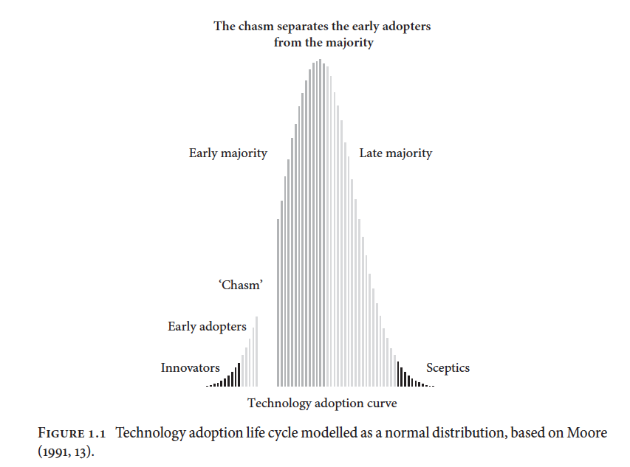
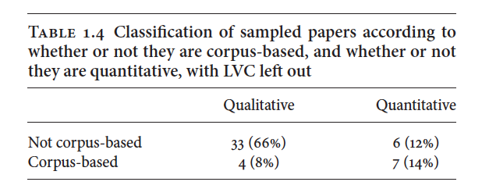
Quantitative historical linguistics
Jenset & McGillivray (2017: 23 ff.)

Slide 17
Quantitative historical linguistics: principles
Principle 1: Consensus
  To achieve the aim of quantitative historical linguistics research, it is necessary to reach consensus among those scholars who accept the premises of quantitative historical linguistics.
Principle 2: Conclusions
  All conclusions in quantitative historical linguistics must follow logically from shared assumptions and evidence available to the historical linguistics community.
Principle 3: Almost any claim is possible
  Every claim has a non-zero probability of being true, unless it is logically or physically impossible.
Principle 4: Some claims are stronger than others
  There is a hierarchy of claims from weakest to strongest.
Principle 5: Strong claims require strong evidence
  The strength of any claim is always proportional to the strength of evidence supporting it.
Principle 6: Possibly does not entail probably
  The inference from ‘possibly’ to ‘probably’ is not logically valid.
Jenset & McGillivray (2017: 45 ff.)

Slide 18
Quantitative historical linguistics: principles
Principle 7:The weakest link
  The conclusion is only as strong as the weakest premise it builds on.
Principle 8: Spell out quantities
  Implicitly quantitative claims are still quantitative and require quantitative evidence.
Principle 9: Trends should be modelled probabilistically
  Quantitative historical linguistics can rely on different types of evidence, but only quantitative evidence can serve as evidence for trends.
Principle 10: Corpora are the prime source of quantitative evidence
  Corpora are the optimal sources of quantitative evidence in quantitative historical linguistics.
Principle 11:The crud factor
  Language is multivariate and should be studied as such.
Principle 12: Mind your stats
Jenset & McGillivray (2017: 45 ff.)
  Quantitative analyses of language data must adhere to best practices in applied statistics.

